Slide 1
Faster Image Compression Using Network Compression
By : Riley Johnson
Raghav Avasthi

Slide 2
Image Compression
Lossy
lossy compression or irreversible compression is the class of data encoding methods that uses inexact approximations and partial data discarding to represent the content.
Lossless
Lossless compression is a class of data compression algorithms that allows the original data to be perfectly reconstructed from the compressed data.
Evaluation Metrics used for Image Compression
PSNR = Peak Signal to Noise Ratio
MS-SSIM = Multi Scale – Structural Similarity for Images
BPP = Bits per pixel

Slide 3
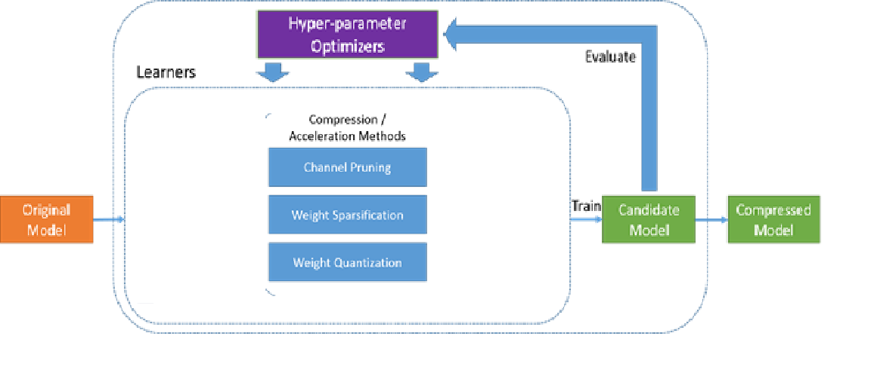
Network Compression
A relatively new research topic in the field of computer vision which aims to reduce the size of a network in memory and make the networks light enough that they can be executed on devices with limited computation power such as portable devices

Slide 4
In-Training / Re-Training techniques
Network Pruning
Weight Quantization
Huffman Coding
Post training Techniques
Weight Quantization
At inference, weights are converted from 8-bits of precision to floating point and computed using floating-point kernels. This conversion is done once and cached to reduce latency.

Slide 5
A matter of scale
Near everyone has a cellphone
Cell Phones have limited CPU power, storage, memory, and battery
Potential for useful tasks with a small enough network

Slide 6
Photo storage
Many people use their phones as a camera
Some people by their phone entirely based on the camera
Hundreds of high def images (12Mb per image)!
Jpeg can only compress so much

Slide 7
Our Project
AIM: The aim of our project is to apply network compression techniques over state-of–the-art image compression networks to achieve state-of-the-art compression on images with execution times viable for practical use.
Motivation: Comparison between 7-zip and Mentzer
 | MS-SSIM | BPP | Compression Time | Decompression Time
7-zip | - | 23 | 0.156 sec | 0.007 sec
Mentzer et al. | 0.982 | 0.4 | ~ 5 mins | ~ 5 mins

Slide 8
Our Approach
Autoencoders!
Train auto encoder and use it for the task of image compression
To compress:
Encode -> Binarize (Pickle) -> Losslessly compress (LZMA)
To restore:
Decompress -> Load tensor -> Decode

Slide 9
Dataset
Kodak
Total 25 uncompressed PNG true color(24 bits per pixel) images of size 768 × 512 pixels released by the Kodak Corporation for unrestricted research usage
Validation Dataset P from CLIC
CLIC = Challenge on Learned Image Compression 2018
Images clicked by professionals, 41 uncompressed PNG images of size ranging from 960x640 to 248x1365

Slide 10
Evaluation Metrics
PSNR = Peak Signal to Noise Ratio
MS-SSIM = Multi Scale – Structural Similarity for Images
BPP = Bits per pixel
Time of Execution

Slide 11
Results
 | PSNR | MS-SSIM | BPP | Compression Time | Decompression Time
7-Zip |  |  |  | 0.156 sec | 0.007 sec
Mentzer et al. | 27-30dB | 0.982 | 0.4 | ~ 5 mins | ~ 5 mins
LZMA-Mentzer C | 30dB | 0.992 | 1.4 | 0.7 sec | 0.01 sec
LZMA-Mentzer B | 29dB | 0.987 | 1 | 0.5 sec | 0.006 sec
LZMA-Mentzer A | 27dB | 0.974 | 0.6 | 0.3 sec | 0.005 sec

Slide 12

Reconstructed Original

Slide 13
How our approach helped Achieve these results

Slide 14
Practical Applications
Cheap and Fast Transmission of Image Data
Less storage required on Devices
Practical usability of the research done in the field of Image Compression

Slide 15
Demo

